Slide 1
R&D Flutter
Part 2- Make effective flutter app
by: Nguyen ba tan

Slide 2
Agenda
UI
Platform-channel
Database
networking
Bloc – architect pattern

Slide 3
UI - widgets
Flutter widgets are built using a modern react-style framework. Widgets describe what their view should look like given their current configuration and state.
Basic widgets:
Text
Row (Horizontal), Column (Vertical)
Stack (Linear Oriented)
Container (BoxDecoration)
More https://flutter.dev/docs/development/ui/widgets/layout & https://flutter.dev/docs/development/ui/widgets/material

Slide 4
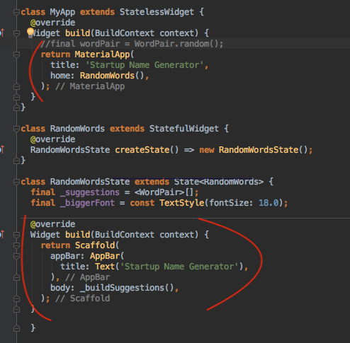
UI - materialapp

Slide 5
UI – design layout
https://flutter.dev/docs/development/ui/layout/tutorial

Slide 6
Platform-channel
Flutter uses a flexible system that allows to call platform-specific APIs whether available in Java or Kolin code on Android, or in Obj-C or Swift code for iOS
Flutter platform-specific API support does not rely on code generation, but rather on a flexible message passing channel.
Flutter portion (client) sends message to the host (iOS or Android portion) over platform channel
The host listen on platform channel, receives the message. Its call into any number of platform-specific APIs (native code) and send back a response to client.

Slide 7
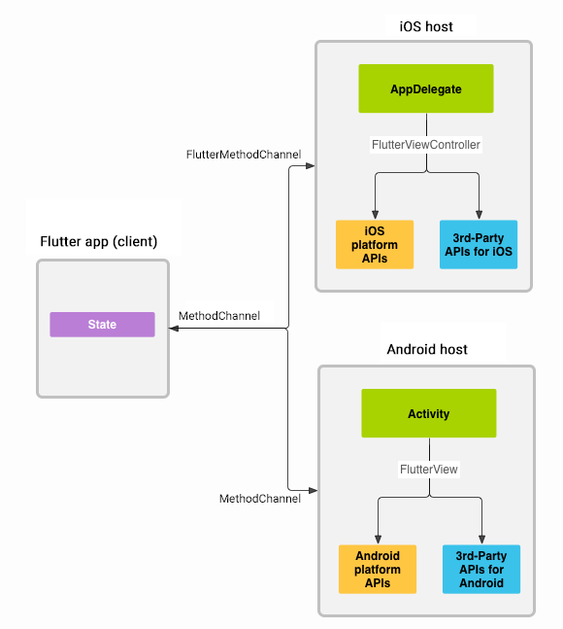
Platform-channel

Slide 8
Platform-channel
Flutter portion

Slide 9
Platform-channel
Android - Kotlin

Slide 10
Platform-channel
iOS- Swift

Slide 11
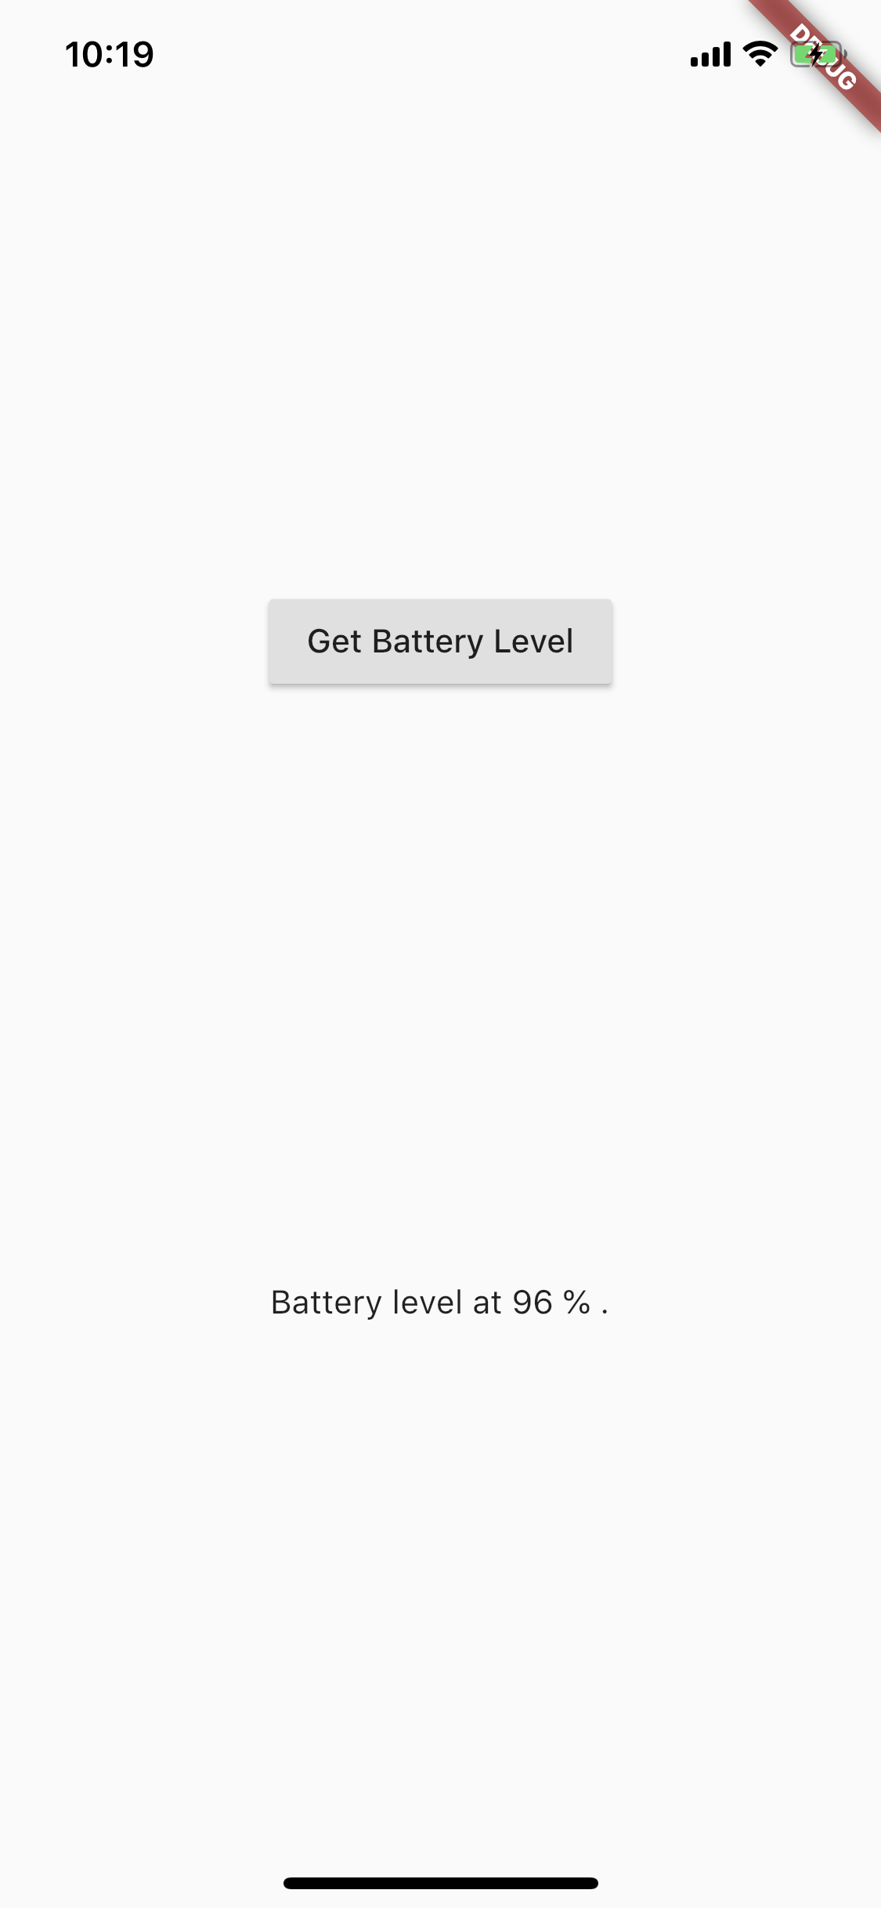
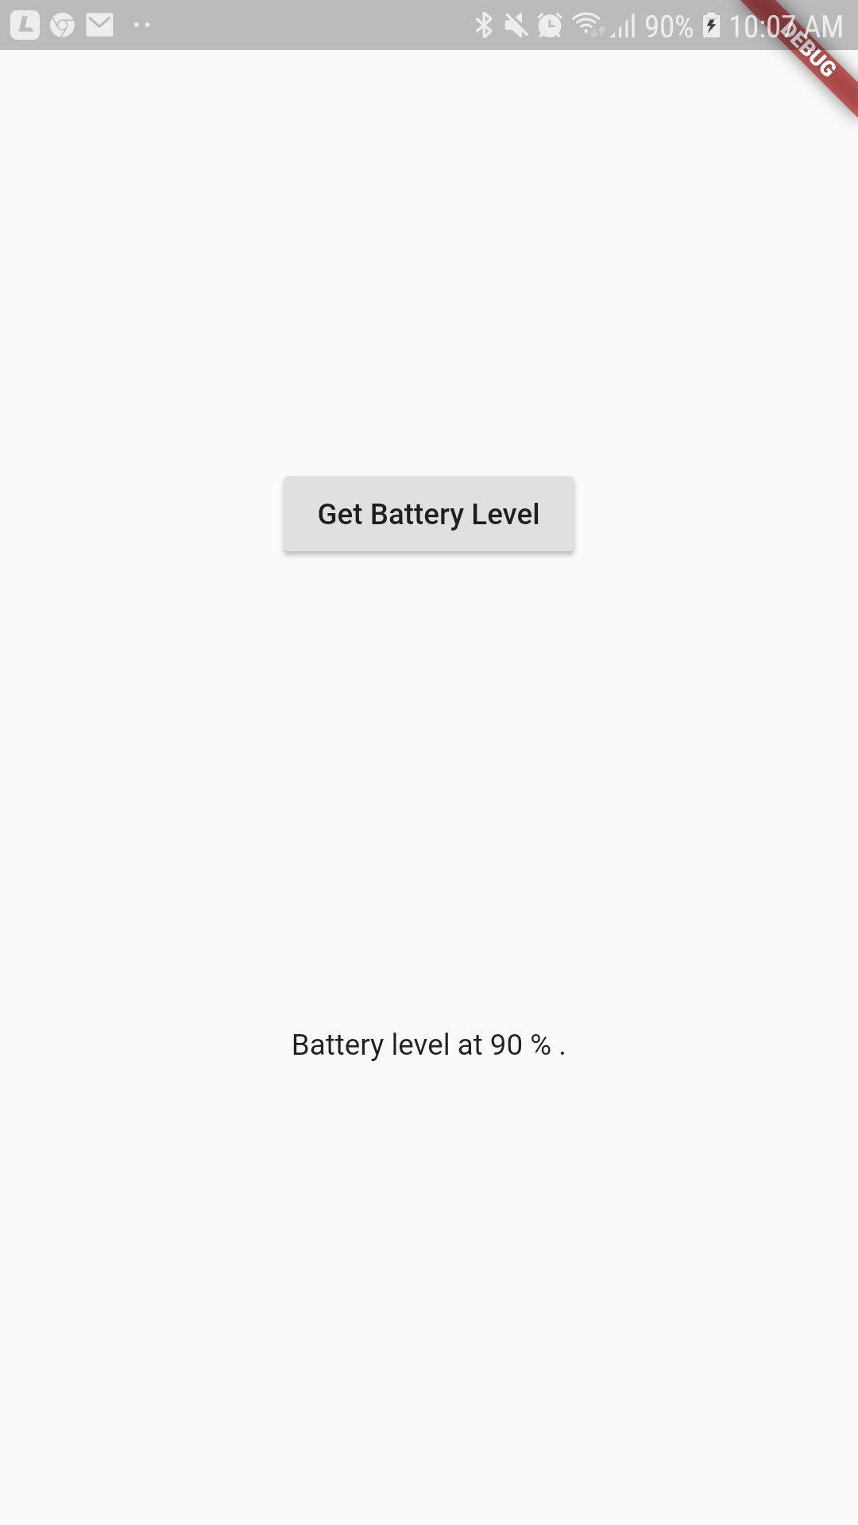
Platform-channel

Slide 12
database

Slide 13
database

Slide 14
database
Asynchronous Programming
Future
Await
Async
then

Slide 15
database

Slide 16
database - sqFlite
Overview & Setup plugin
Create database model class
Create database helper class
Performing CRUD operation

Slide 17
database - sqFlite
Overview & Setup plugin
https://pub.dartlang.org/

Slide 18
database - sqFlite
Model class

Slide 19
database - sqFlite
Helper class

Slide 20
database - sqFlite
CRUD operation

Slide 21
Networking
Add http package in pubspec.yaml

Slide 22
Networking
Make network request
The compute function runs expensive functions in a background isolate and return the result
https://api.flutter.dev//flutter/foundation/compute.html
Future<List<Photo>> fetchPhotos(http.Client client) async { final response = await client.get('https://jsonplaceholder.typicode.com/photos'); // Use the compute function to run parsePhotos in a separate isolate return compute(parsePhotos, response.body); }

Slide 23
Networking
Parse & Convert JSON data

Slide 24
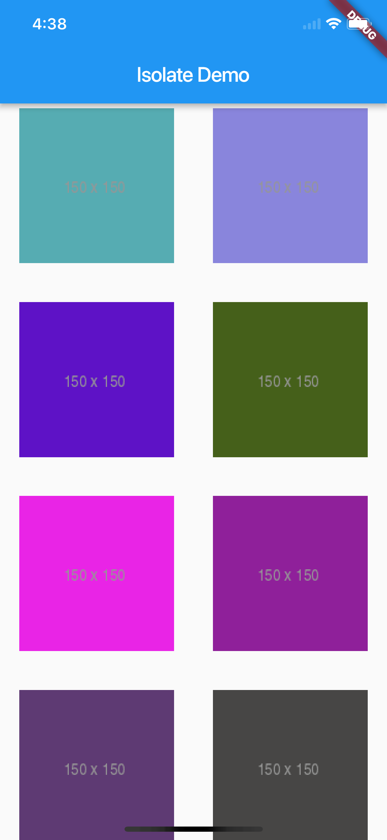
Networking

Slide 25
Bloc architect
Stream

Slide 26
Bloc architect
BLoC, Business Logic Component, is a pattern recommended by Google.
STREAM or REACTIVE approach. Data will be flowing from BLOC to the UI or from UI to the BLOC in the forms of streams.

Slide 27
Bloc architect
App structure

Slide 28
Bloc architect
BloC implementation

Slide 29
Bloc architect
Connect UI with BLoC

Slide 30
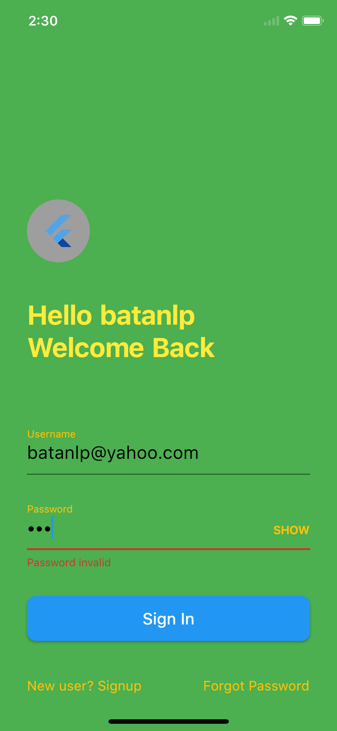
Bloc architect

Slide 31
Q&A

